Slide 1

Critical Thinking in English
Critical Essay

Slide 2
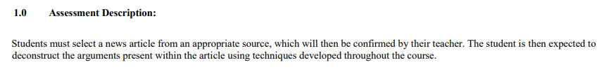
The Question

Slide 3
Key Points
Appropriate source – not a teaching source
News article – opinion pieces and editorials make good choices.
The arguments – can be taken from the whole, or just part of the article.

Slide 4
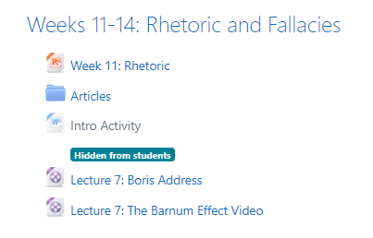
You can choose an article

Slide 5

The Question

Slide 6
Key Point?
Identify source – get teacher’s confirmation that the source is suitable IF CHOOSING YOUR OWN
Identify and assess the main arguments

Slide 7
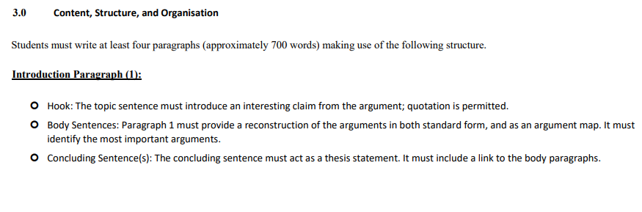
Content, Structure and Organisation

Slide 8
Paragraph 1 – The Hook
The Hook – an interesting claim from the article. Something shocking, surprising or unusual in some way. Perhaps pose a question that makes your reader want to find the answer.
“Can you believe that the most powerful man in the world doesn’t believe in global warming?”

Slide 9
Paragraph 1 – The Body
The body – provides a reconstruction of the argument.
This will be presented in standard form(s) and argument map(s).

Slide 10
Paragraph 1 – Concluding Sentence
Concluding sentence – acts as a thesis statement. It must provide an overview of the essay.
States that the paragraphs will analyse the arguments by…

Slide 11
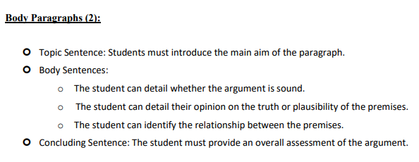
Content, Structure and Organisation

Slide 12
Paragraph 2 – Topic Sentence
Topic sentence – highlight what the paragraph is going to do.
States what will be analysed within the paragraph (the argument structure and whether the premises are true).

Slide 13
Paragraph 2 – Body Sentences
Body sentence – provide an analysis of the quality of the premises (plausibility/truth and relationship with conclusion).
State the relationship between the premises.
Analyse the structure. (Valid? Forceful?)
Analyse whether the premises are true. (Sound?)
You may wish to state what type of inductive argument is presented.

Slide 14
Paragraph 2 – Concluding Sentence
Concluding sentence – provide an overall assessment of the argument.
Summarise the information in the paragraph.

Slide 15
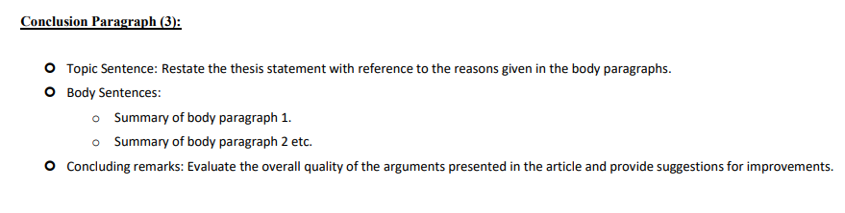
Content, Structure and Organisation

Slide 16
Paragraph 4 – Topic Sentence
Topic sentence – restate the thesis statement with reference to the body paragraphs.
PARAPHASE – Do not use the same language as in your thesis statement but present the same message.

Slide 17
Paragraph 4 – Body Sentences
Body sentence – summarise body paragraphs 1, 2....
Again paraphrase appropriately.

Slide 18
Paragraph 3 – Concluding Sentence
Concluding sentence – provide an overall assessment of the article and the main arguments presented.
Suggest ways in which the arguments could be improved.

Slide 19
Marking?
The Critical Essay will be marked using 5 key criteria:
Content
Organisation
Mechanics
Terminology
Critical Analysis and Logical Clarity

Slide 20
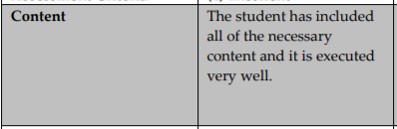
What does content refer to?

Slide 21
Common Content Issues – Formative Essay
Do not include outside research unless it is to directly disprove a proposition.
In paragraph 2, only analyse what you have included in your reconstruction of the argument.
Do not create your own argument.
Do not analyse what the article does not mention unless it is in direct relation to a proposition.
Premise 1 states A but that clearly ignores B.

Slide 22
Content
Follow the guidance provided in this PPT and you will get a good mark for content.

Slide 23
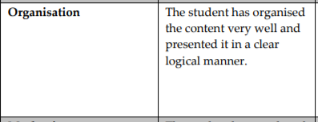
What does organisation refer to?

Slide 24
Common Organisational Issues – Formative Essay
Make sure you include a hook.
Order you body paragraph in a logical way (ascending/descending argument quality)

Slide 25
Organisation
Follow the guidance provided in this PPT and you will get a good mark for organisation.

Slide 26
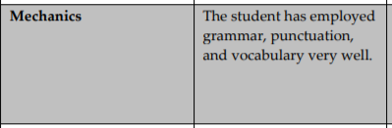
What does mechanics refer to?

Slide 27
Mechanics
Here you are being marked on your use of English.
Grammar – try and use a range of simple and complex structures. (Academic writing generally contains a lot of multi-clausal sentences.)
Punctuation – particularly the use of commas (,) and semicolons (;).
Vocabulary- here refers to the use of vocabulary from an Academic English perspective.

Slide 28
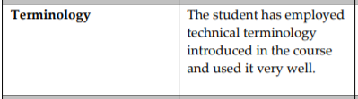
What does terminology refer to?

Slide 29
Terminology
Deductive, inductive, valid, invalid, forceful, unforceful, premise, proposition, conclusion, sound, unsound, etc…

Slide 30
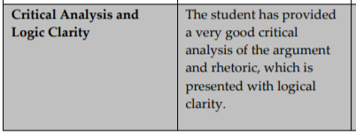
Critical Analysis and Logical Clarity

Slide 31
Critical Analysis and Logical Clarity
How well have the individual premises been analysed?
Truth/plausibility
How well has the argument structure been analysed?
Valid/forceful
How well has the argument been analysed overall?
Soundness

Slide 32
General advice
.
700 words is a guide. If you write slightly more/less that will not be a problem.
Do not include a copy of the article, but instead add it as a link.
When presenting the argument, do so in your own words. Remember standard form should be a simplification, not directly copied from the text.

